Slide 1

An Exploration of Chaos Engineering Techniques on a Self-Healing Cloud Native Microservice Architecture
Bruno Franco
0.0.1

Slide 2

Agenda
INTRODUCTION
Research question
Experiment
Results
Your conclusions!

Slide 3

INTRODUCTION
Microservices
An architectural approach that organizes an application into a set of services characterized by the following attributes:
Capable of independent deployment.
Loosely interconnected.
Aligned with specific business functionalities.
Managed by small, dedicated teams.

Slide 4
INTRODUCTION
Cloud infrastructure
Cloud computing is the on-demand delivery of IT resources over the Internet with pay-as-you-go pricing.

Slide 5
INTRODUCTION
Self-healing systems
Self-healing systems perform periodic health assessments on various components and autonomously initiate corrective actions, such as redeployment, to restore them to their intended operational conditions (Ghosh, et al., 2007).

Slide 6
INTRODUCTION
Chaos engineering techniques
Involves conducting systematic experiments on a system to instill confidence in its capacity to endure challenging operational conditions (Rosenthal and Jones, 2020). In software development, it is common to specify the need for a software system to gracefully handle failures while maintaining an acceptable level of service quality

Slide 7

Research question
Let’s Dive In
Can Chaos Engineering techniques implemented via AWS Fault Injector Simulator (FIS) degrade an ‘Industry standard Self-healing Cloud-based microservice architecture’ beyond a one-minute response-time SLO?

Slide 8
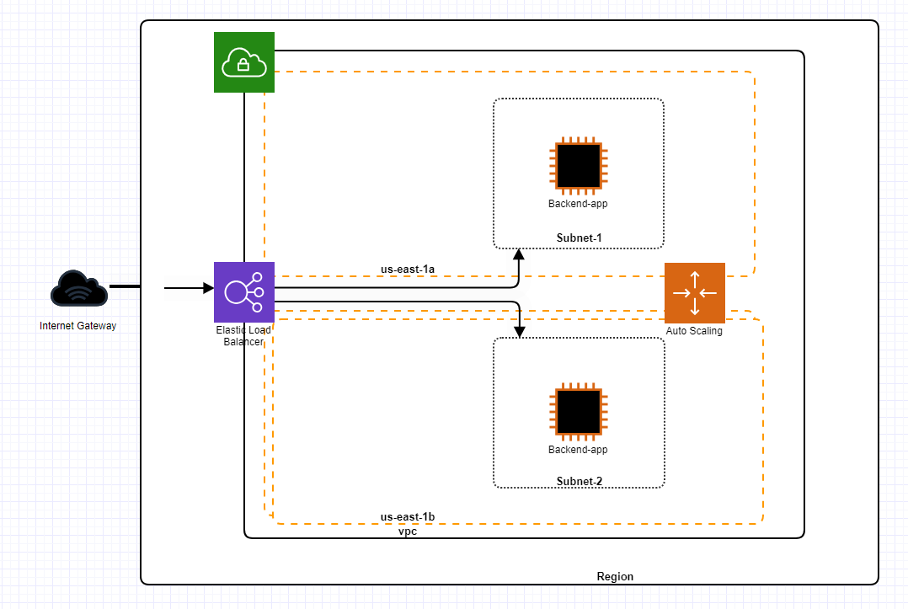
AWS Architecture

Slide 9
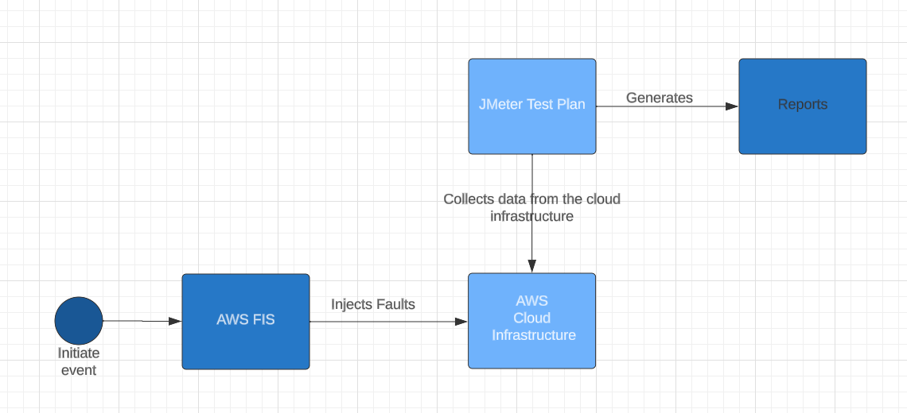
Experiment design

Slide 10
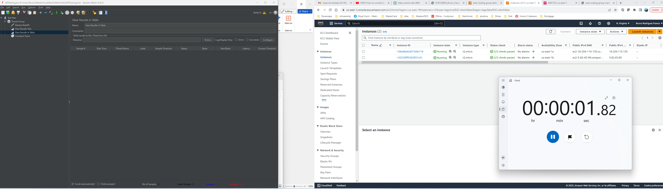
sample
Step 1

Slide 11
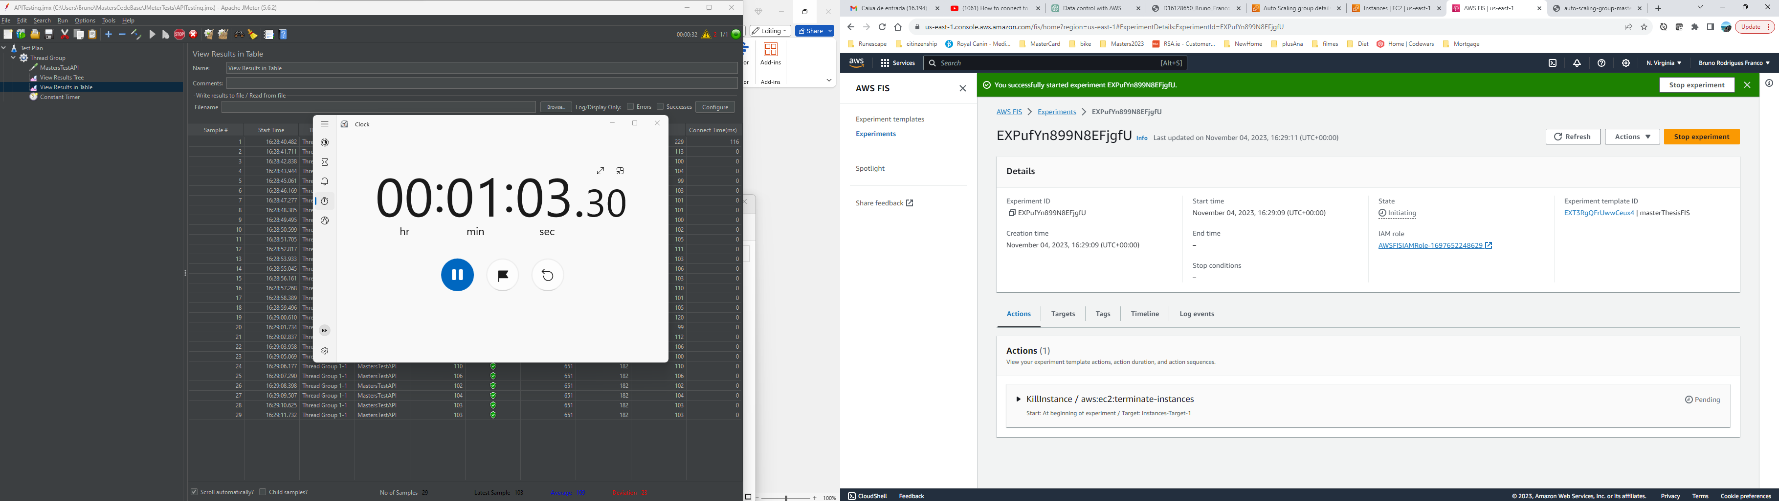
sample
Step 2

Slide 12
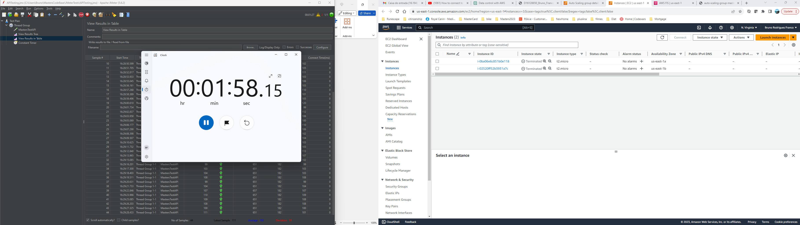
sample
Step 3

Slide 13
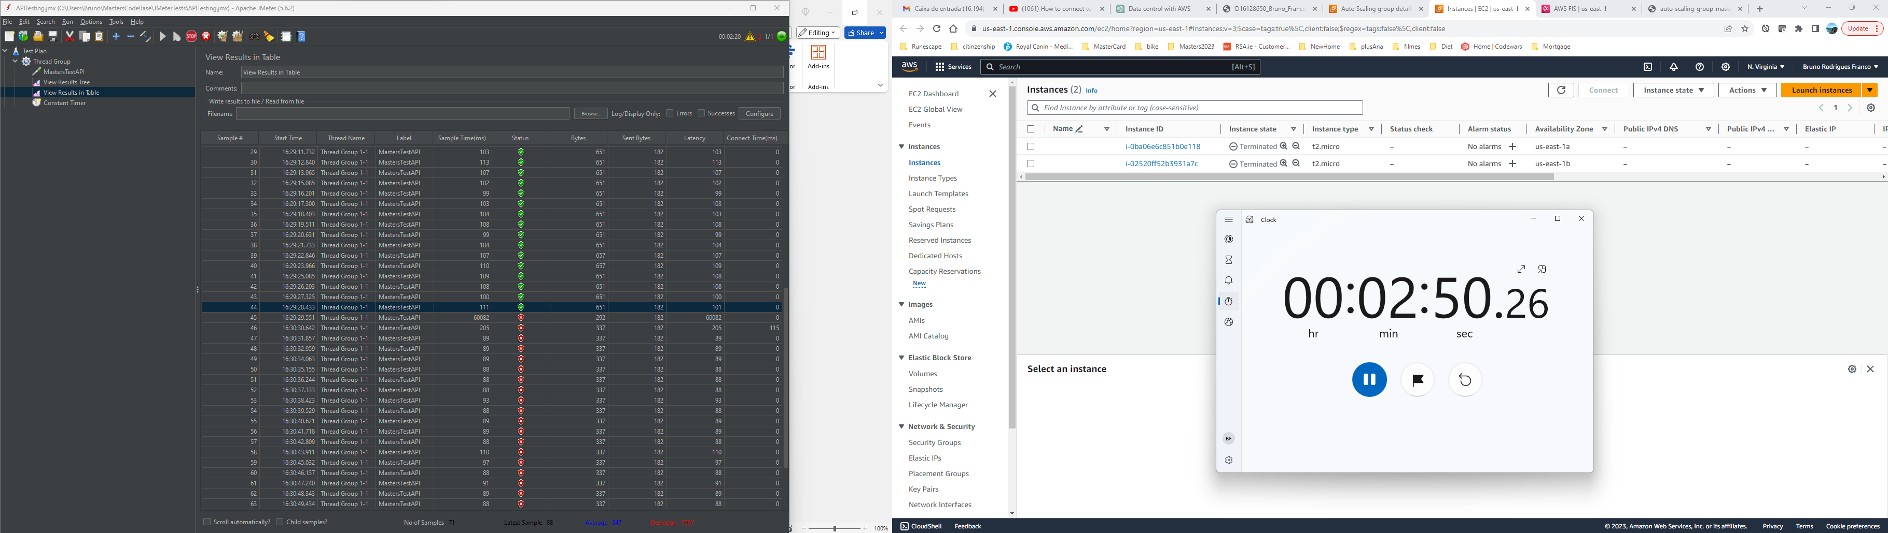
sample
Step 4

Slide 14
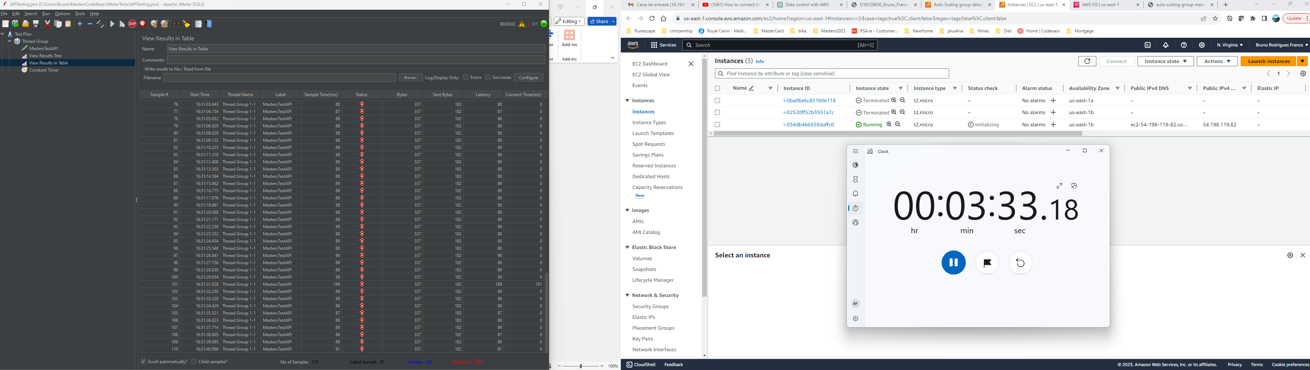
sample
Step 5

Slide 15
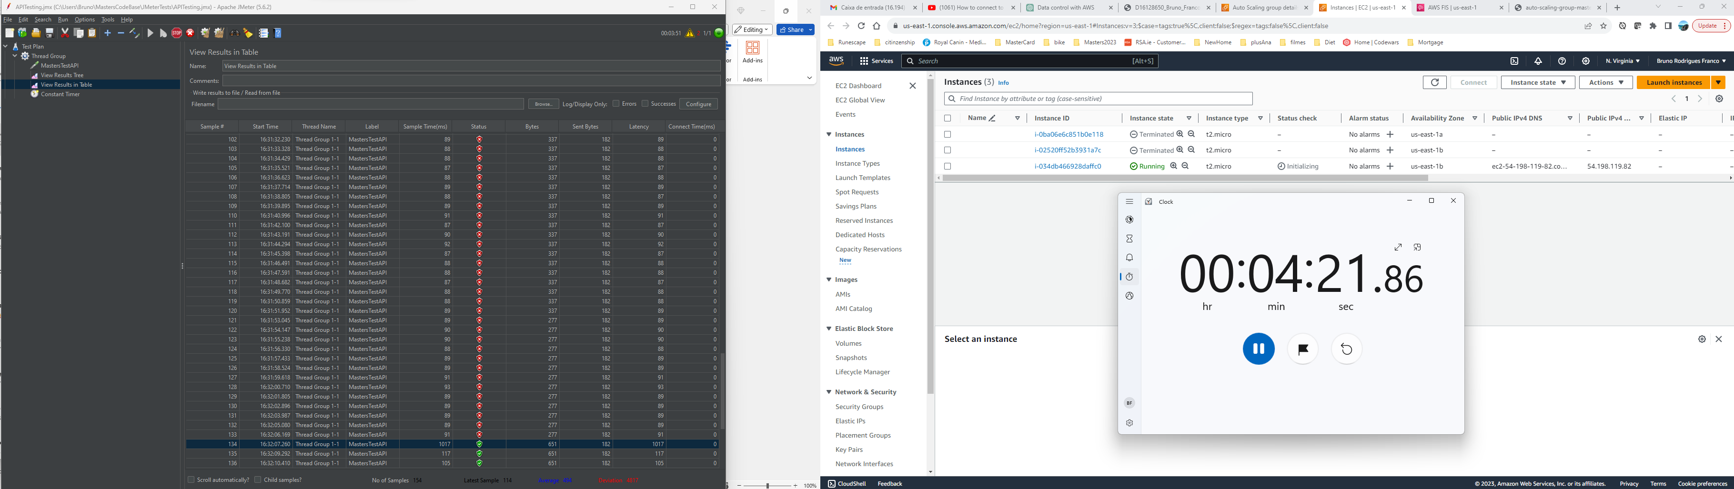
sample
Step 6

Slide 16
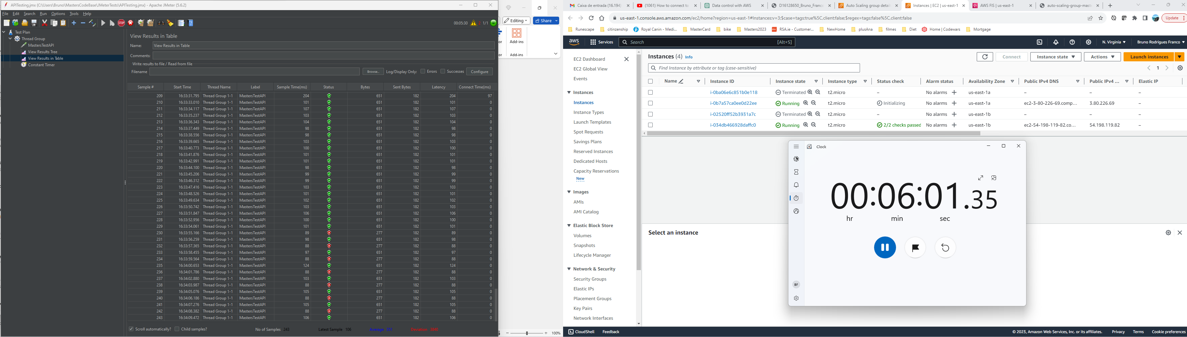
sample
Step 7

Slide 17
AWS configuration variation
Warm pooling
The experiment was executed in four different phases (differentiated by auto-scaling configurations), eight times each as well:
No warm pooling.
Warm pooling with one instance on ‘Stopped’ state.
Warm pooling with one instance on ‘Running’ state.
Warm pooling with one instance on ‘Hibernated’ state.

Slide 18

Results
Incoming diagrams!

Slide 19
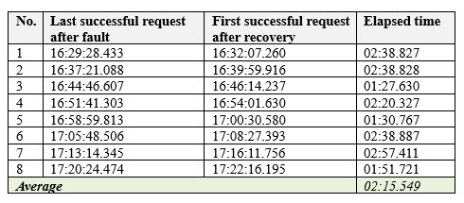
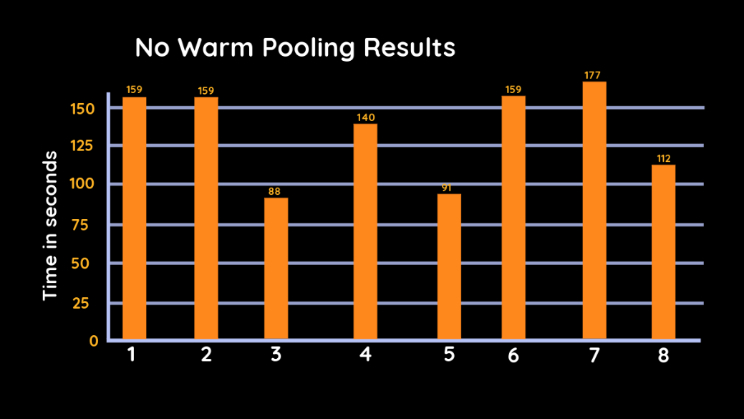
No warm pooling

Slide 20
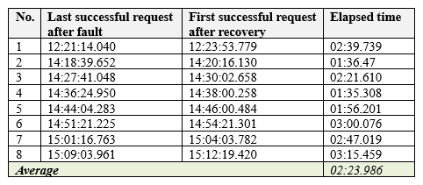
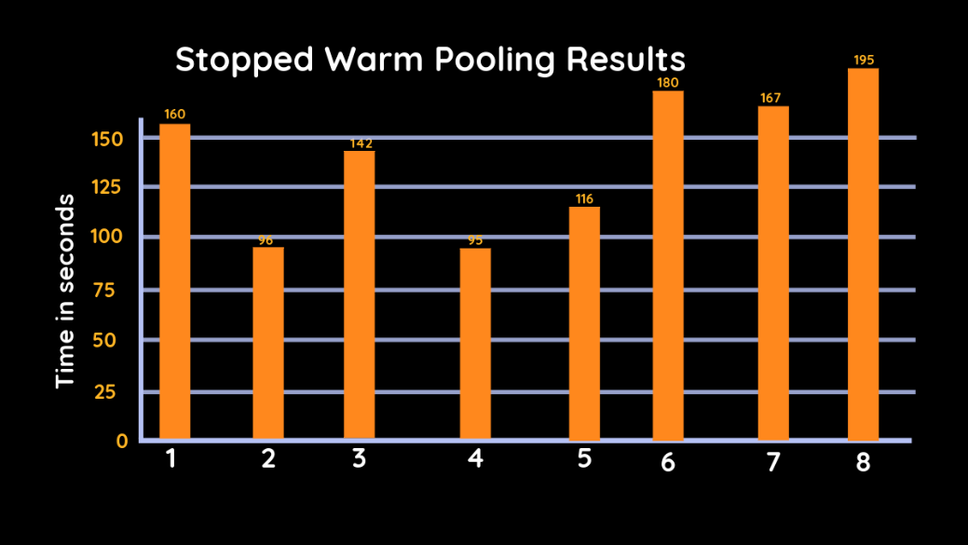
stopped warm pooling

Slide 21
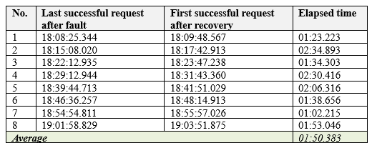
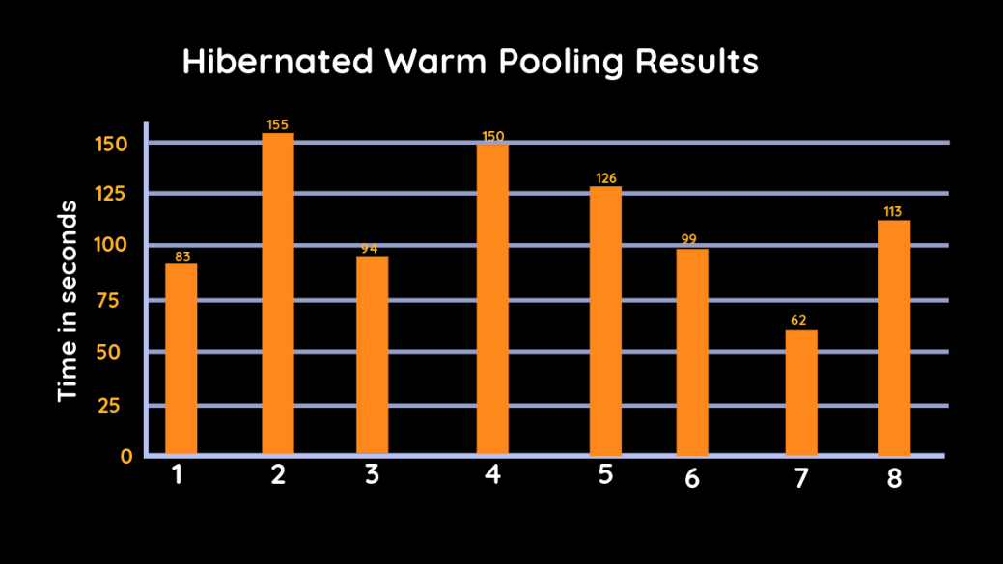
hibernated warm pooling

Slide 22
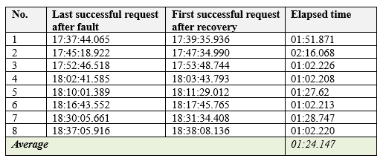
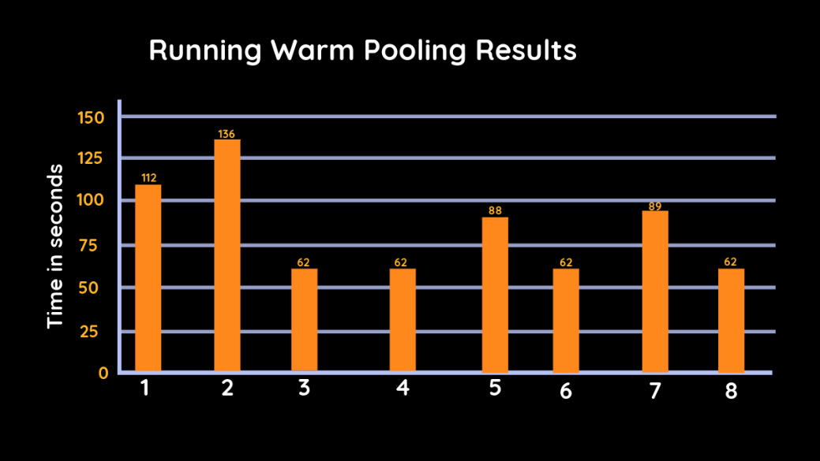
running warm pooling

Slide 23
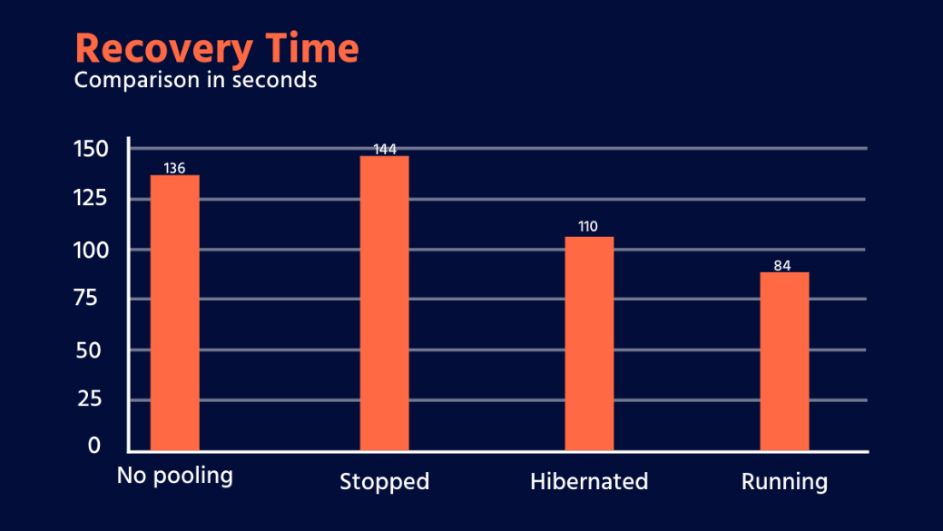
Recovery time per pool
No warm pooling recovery time: 02:15.549
Stopped warm pooling recovery time: 02:23.986
Hibernated warm pooling recovery time: 01:50.383
Running warm pooling recovery time: 01:24.147

Slide 24
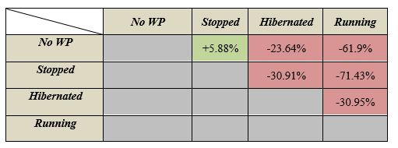
Recovery time comparison

Slide 25

Conclusions:
Warm-up questions:
How many years experience in Software Engineering
Business Domains
Cloud Domains
Choice of tools
Would you have chosen the tools/platforms differently?
AWS x FIS x JMeter
Experiment validation
Are you satisfied with how the experiment was conducted?
Would you have done it differently?
What should I have measured differently?
Is there anything else I should have measured?
results
Are the results as you have expected?
Which warm pooling configuration would you recommend?
What can you conclude from the experiment results?

Slide 26
THANK YOU
I appreciate your time!

